Slide 1

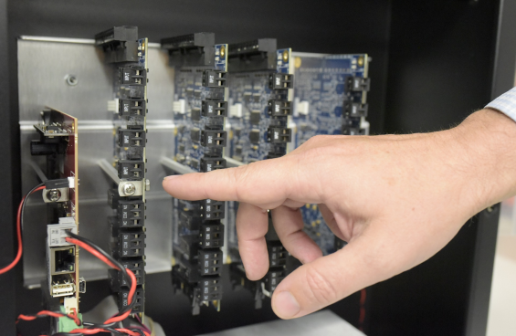
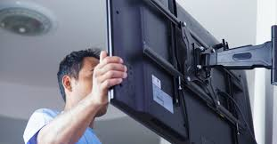











Project management
Full Service Low Voltage Management
Cabling & IT Set-up
• Cable tray & conduit inspection • Cable pulling • Rack Installation • Cable termination (IT room side) • UPS installation & Configuration • Network equipment installation & Configuration • Cable termination (User side) • T&C
AV Systems
• Cable tray & conduit inspection • AV System Cable pulling • AV equipment installation (Rack side) • AV equipment installation & Configuration • T&C
Security System
• Cable tray & conduit inspection Security System Cable pulling • Security equipment installation (Rack side) • Security equipment installation & Configuration • T&C IT Systems testing e. Customer Training

Slide 2
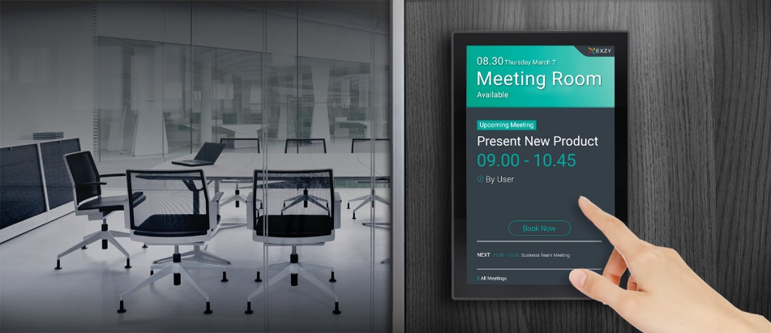



Audio Visual Expertise
Single Partner Strategy
  We can tailor your AV needs and provide all major brands
Simple pricing model
  We can scope out AV pricing clearly in single BOM and provide estimates for budgeting projects
Wide Ranging Solution Offerings
  Meeting room booking
  Web conferencing
  Facial Recognition
  HD Security
  Telepresence
  Display Wall Systems

Slide 3







  IT Hardware Product Lines
Servers | PowerEdge -Rack, Blade, Tower | Proliant ML/DL/SL Blade BL | Wintel xSeries (Lenovo) Power iSeries & pSeries | Sunfire/Sunray Sparc/Ultra Enterprise Netra/ T series Blades M Series | B series C series
Storage | PowerVault MD Series (DAS, NAS, SAS) Equallogic Compellent | StorageWorks MSA range EVA range | FAStT range DS Range | StorEdge STK Series | DSMK Series FAST Series V-Series | CX – Clariion FC Series VNX Celerra
NAS | PowerVault NX Series | 1000 Series 1500 Series 2000 Series B & DL Series | 519x N series Appliance
TAPE | All Single Drives PowerVault ML & TL Ranges | All Single Drives StorageWorks MSL EML ESL | All Single Drivers 3xxx range 4xxx range TS Series libraries | All Single Drives L Series SL Series StorEdge Range
Networking Equipment | Dell PowerConnect | ProCurve FC Switches HP/Brocade MDS/Cisco | 17xx Series 2xxx Series 3xxx Series 5xxx Series 8xxx Series |  | Switching Products Routing Products Security Products Wireless Products
Other brands we carry: Fujitsu, Quantum, Brocade, Alcatel Lucent, Aten, APC, Juniper & more.

